Slide 1
RNAseq study of SMN2 splice-modulator lead compounds
Zhen Gao
09/14/2023

Slide 2
SMN2 RNAseq study
Goal: Perform RNAseq on key compound hits to identify on and off-target activity.
Compare to competitor Risdiplam.
12 Compounds:
BIO-2196772
BIO-1949634
BIO-2207180
BIO-2178782
BIO-2196895
BIO-2197306
BIO-2206678
BIO-2201042
BIO-2204984
BIO-2199562
BIO-2186827
Risdiplam
Controls:
DMSO
Cell model:
GM09677c [SMA fibroblasts]
SHSY5Y [common to HTT program]
Doses
3X_IC50
10X_IC50
Samples: 4 replicates per sample, 2 doses per each of 12 compounds, 4 DMSO x 2 cell lines
**IC50 determined in GM09677c [qPCR screening]
Total # Samples: 184
[Christina Gallo]

Slide 3
DSG Counts in ShSy5Y on-Targets (7 compounds + risdiplam vs DMSO)
Comparison | HTT | SMN1 | SMN2
dPSI_SH_BIO_1949634_10x_vs_SH_DMSO | NA | -0.251542 | -0.4028676
dPSI_SH_BIO_1949634_3x_vs_SH_DMSO | NA | NA | -0.3424944
dPSI_SH_BIO_2178782_10x_vs_SH_DMSO | 0.33240197 | NA | -0.3834702
dPSI_SH_BIO_2178782_3x_vs_SH_DMSO | -0.3694164 | NA | -0.3811666
dPSI_SH_BIO_2196772_10x_vs_SH_DMSO | 0.54427119 | -0.2536106 | -0.4013308
dPSI_SH_BIO_2196772_3x_vs_SH_DMSO | -0.3446866 | NA | -0.3632981
dPSI_SH_BIO_2196895_10x_vs_SH_DMSO | -0.2536149 | NA | -0.3934613
dPSI_SH_BIO_2196895_3x_vs_SH_DMSO | NA | NA | -0.2893154
dPSI_SH_BIO_2197306_10x_vs_SH_DMSO | 0.34409763 | NA | -0.3940991
dPSI_SH_BIO_2197306_3x_vs_SH_DMSO | NA | NA | -0.3173035
dPSI_SH_BIO_2199562_10x_vs_SH_DMSO | 0.32487121 | NA | -0.3549552
dPSI_SH_BIO_2199562_3x_vs_SH_DMSO | 0.25555825 | NA | -0.3265951
dPSI_SH_BIO_2204984_10x_vs_SH_DMSO | -0.3318012 | NA | -0.3607647
dPSI_SH_BIO_2204984_3x_vs_SH_DMSO | NA | NA | NA
dPSI_SH_BIO_2207180_10x_vs_SH_DMSO | NA | NA | -0.2540779
dPSI_SH_BIO_2207180_3x_vs_SH_DMSO | NA | NA | NA

Slide 4
DSG Counts in ShSy5Y on-Targets (7 compounds vs risdiplam)
Comparison | HTT | SMN1 | SMN2
dPSI_SH_BIO_2178782_10x_vs_SH_BIO_1949634_10x | 0.2549246 | NA | NA
dPSI_SH_BIO_2178782_3x_vs_SH_BIO_1949634_3x | -0.3524674 | NA | NA
dPSI_SH_BIO_2196772_10x_vs_SH_BIO_1949634_10x | 0.40863679 | NA | NA
dPSI_SH_BIO_2196772_3x_vs_SH_BIO_1949634_3x | -0.3278819 | NA | NA
dPSI_SH_BIO_2196895_10x_vs_SH_BIO_1949634_10x | NA | NA | NA
dPSI_SH_BIO_2196895_3x_vs_SH_BIO_1949634_3x | NA | NA | NA
dPSI_SH_BIO_2197306_10x_vs_SH_BIO_1949634_10x | 0.29922826 | NA | NA
dPSI_SH_BIO_2197306_3x_vs_SH_BIO_1949634_3x | NA | NA | NA
dPSI_SH_BIO_2199562_10x_vs_SH_BIO_1949634_10x | 0.28288136 | NA | NA
dPSI_SH_BIO_2199562_3x_vs_SH_BIO_1949634_3x | -0.3685617 | NA | NA
dPSI_SH_BIO_2204984_10x_vs_SH_BIO_1949634_10x | -0.2721019 | NA | NA
dPSI_SH_BIO_2204984_3x_vs_SH_BIO_1949634_3x | NA | NA | NA
dPSI_SH_BIO_2207180_10x_vs_SH_BIO_1949634_10x | NA | NA | NA
dPSI_SH_BIO_2207180_3x_vs_SH_BIO_1949634_3x | NA | NA | NA

Slide 5
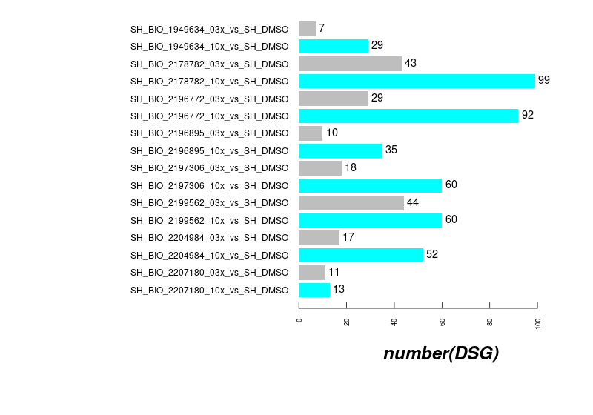
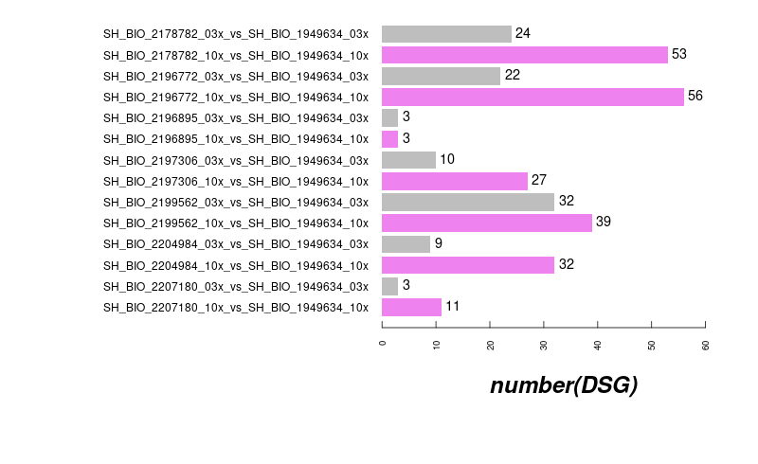
DSG Counts in ShSy5Y off-Targets (7 compounds + risdiplam)

Slide 6
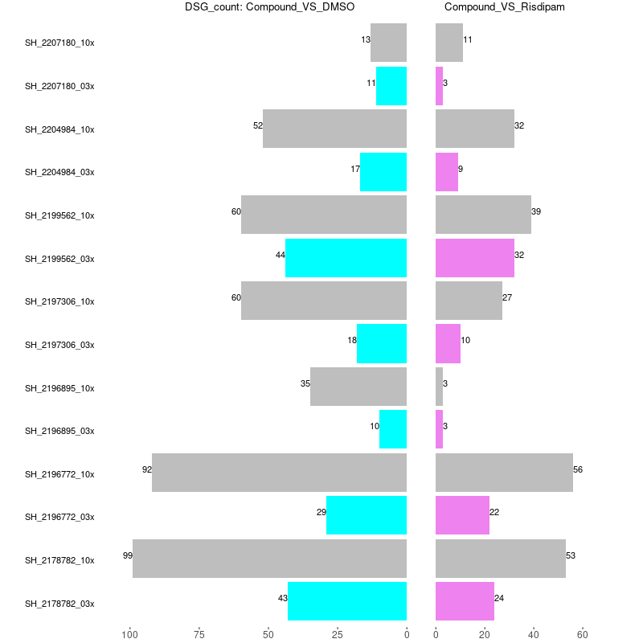
DSG Counts in ShSy5Y off-Targets (7 compounds + risdplam)

Slide 7
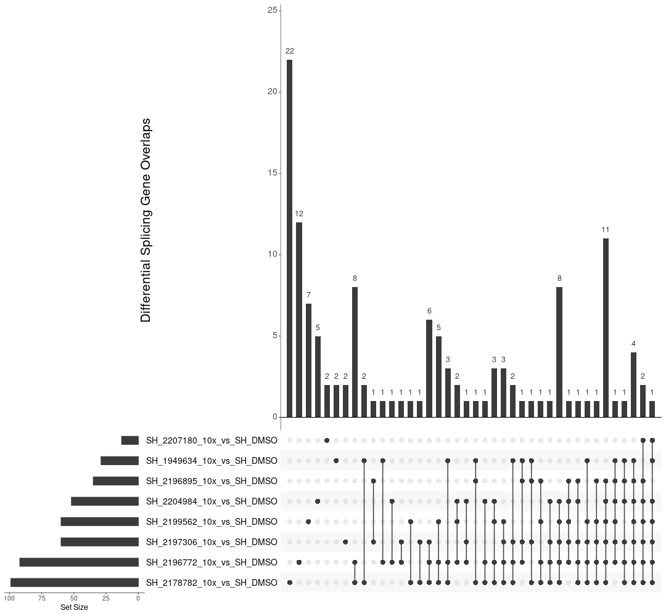
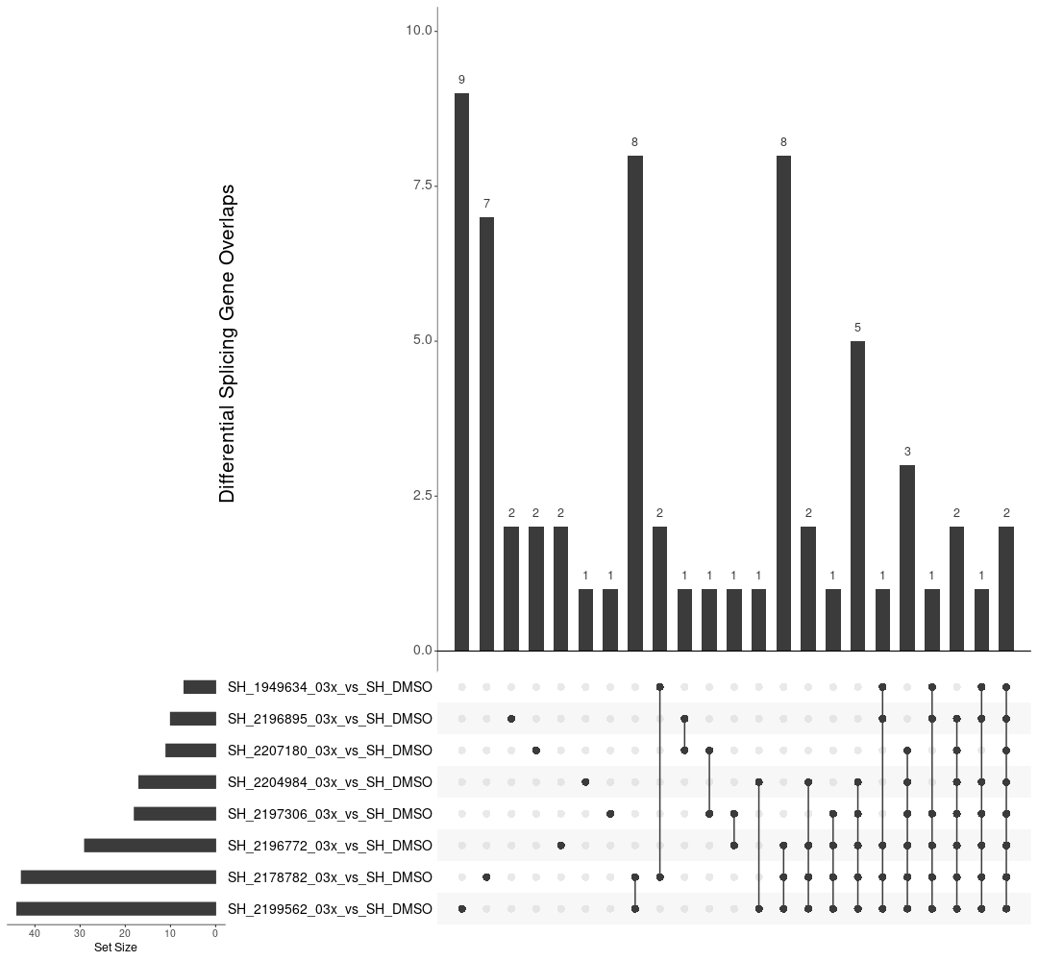
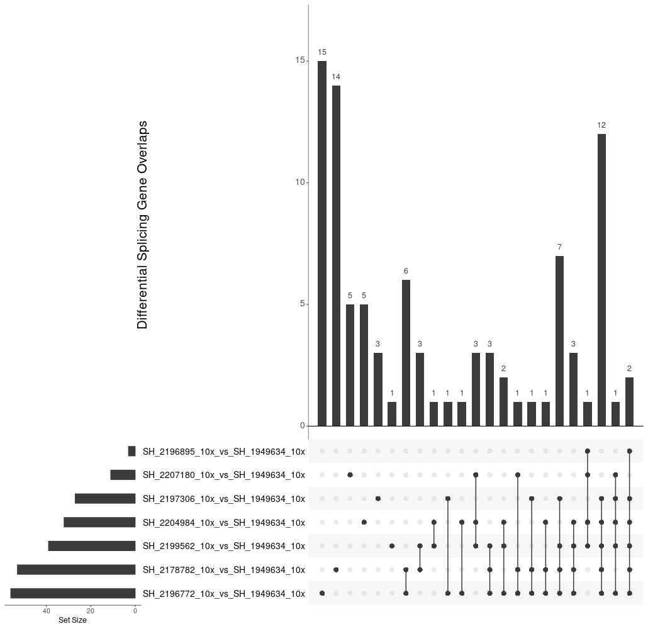
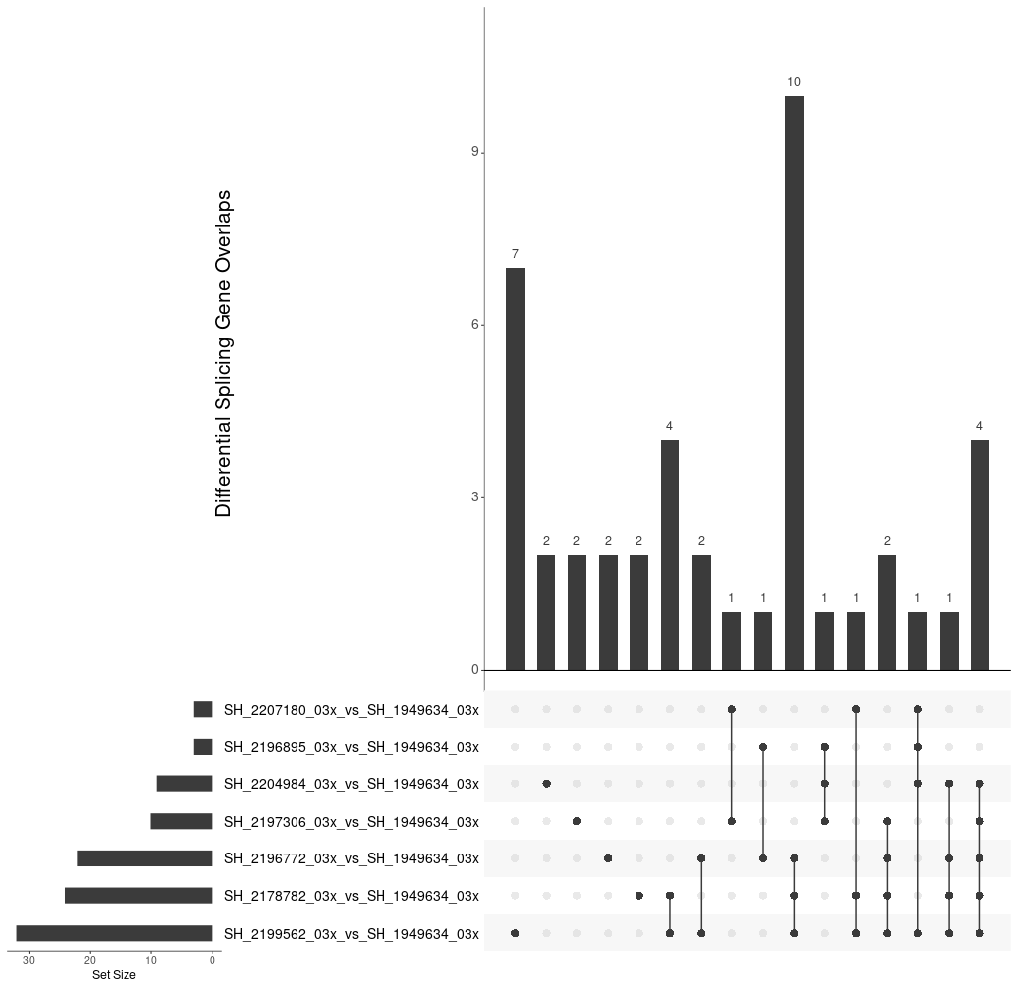
DSG Counts in ShSy5Y off-Targets (7 compounds + risdplam)

Slide 8
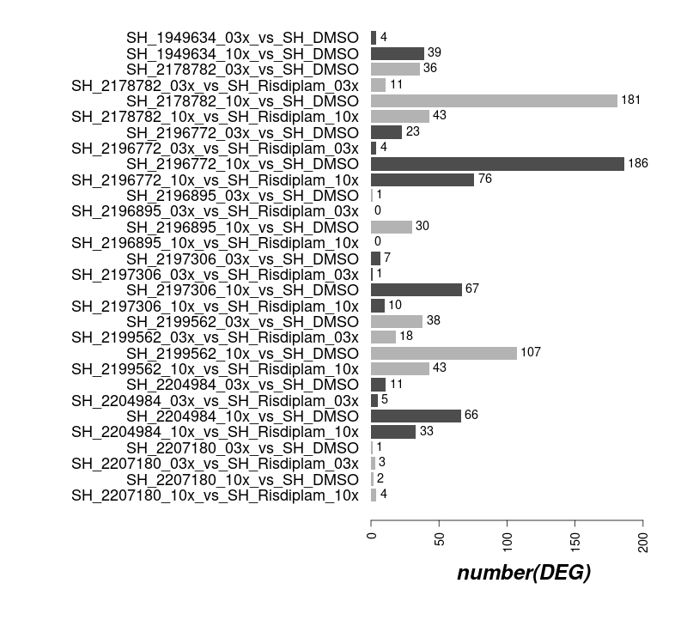
DEG Counts in ShSy5Y off-Targets (7 compounds + risdplam)

Slide 9
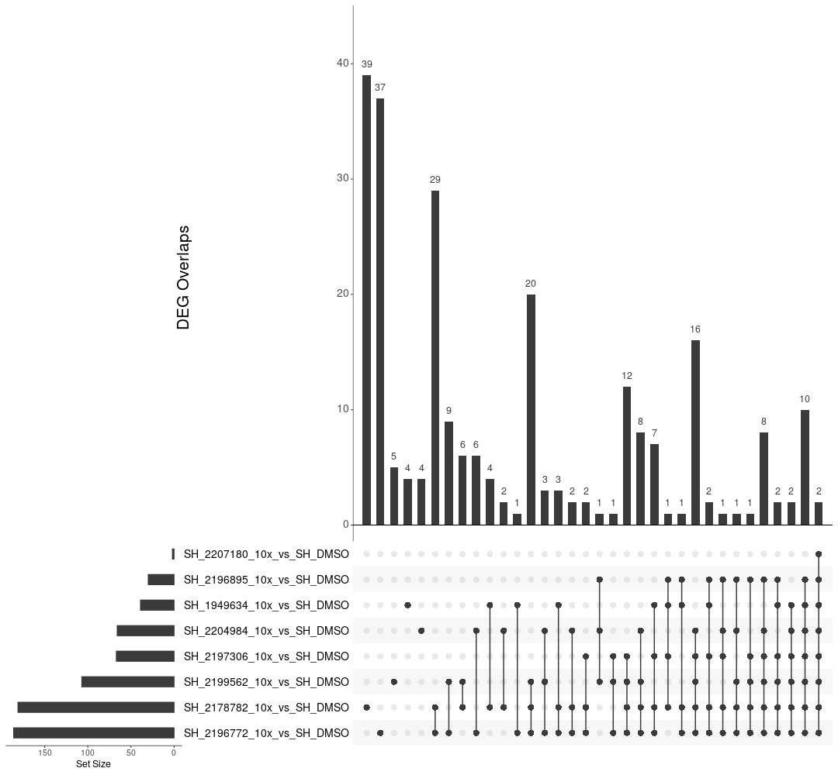
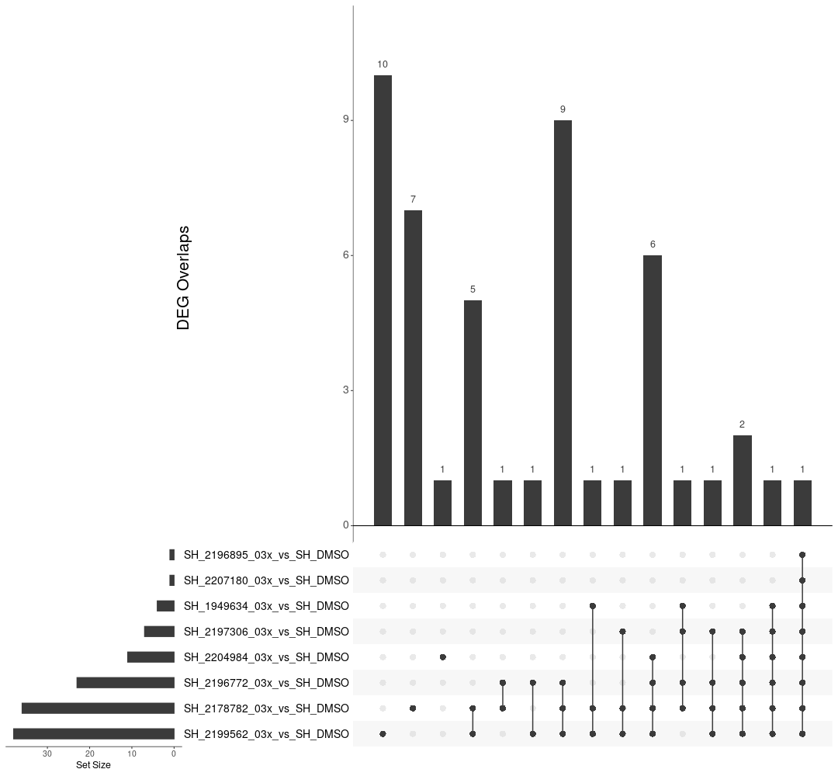
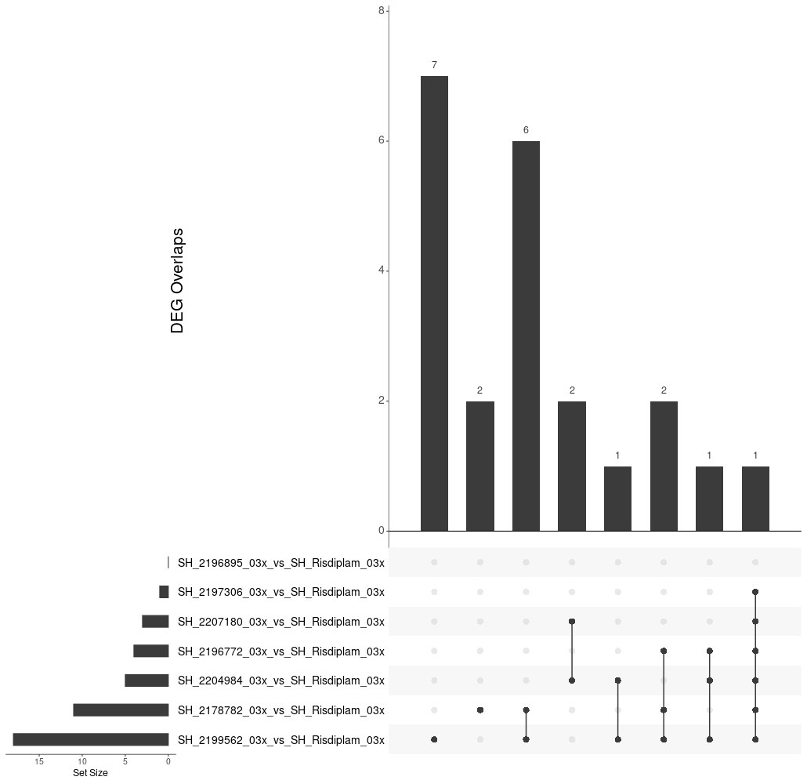
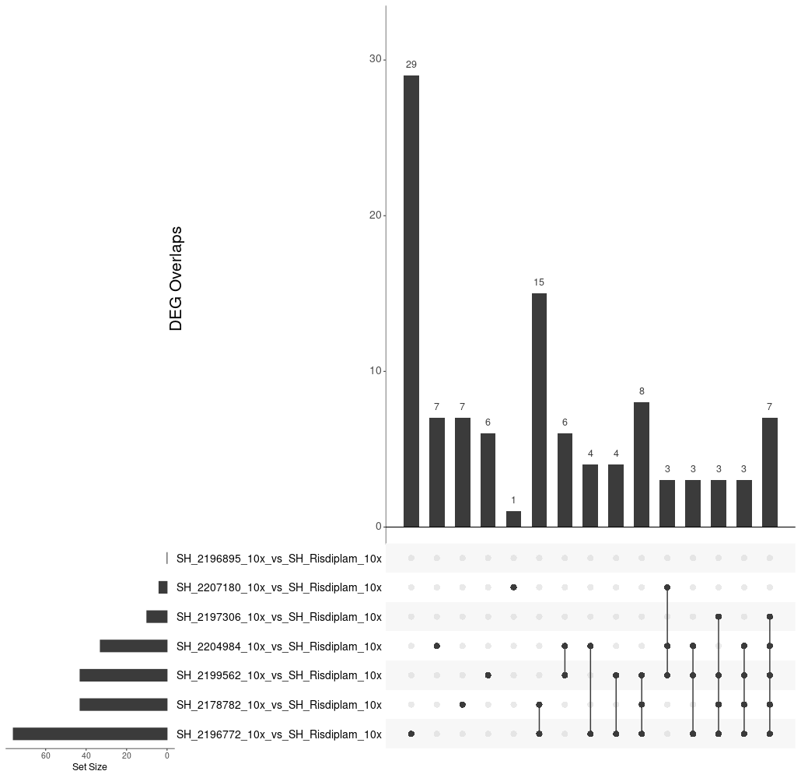
DEG Counts in ShSy5Y off-Targets (7 compounds + risdplam)

Slide 10
DSG Counts in GM fibroblasts on-Targets (11 compounds + risdplam vs DMSO)
Comparison | HTT | SMN2
dPSI_GM_BIO_1949634_10x_vs_GM_DMSO | NA | -0.2746671
dPSI_GM_BIO_1949634_3x_vs_GM_DMSO | NA | NA
dPSI_GM_BIO_2178782_10x_vs_GM_DMSO | 0.582198416 | -0.2861569
dPSI_GM_BIO_2178782_3x_vs_GM_DMSO | 0.266403816 | -0.2665936
dPSI_GM_BIO_2186827_10x_vs_GM_DMSO | NA | -0.2757955
dPSI_GM_BIO_2186827_3x_vs_GM_DMSO | 0.367161961 | NA
dPSI_GM_BIO_2196772_10x_vs_GM_DMSO | 0.539776822 | -0.2807347
dPSI_GM_BIO_2196772_3x_vs_GM_DMSO | NA | -0.261674
dPSI_GM_BIO_2196895_10x_vs_GM_DMSO | NA | -0.2743404
dPSI_GM_BIO_2196895_3x_vs_GM_DMSO | NA | NA
dPSI_GM_BIO_2197306_10x_vs_GM_DMSO | NA | -0.28458
dPSI_GM_BIO_2197306_3x_vs_GM_DMSO | NA | -0.2543306
dPSI_GM_BIO_2199562_10x_vs_GM_DMSO | 0.473243372 | -0.2740286
dPSI_GM_BIO_2199562_3x_vs_GM_DMSO | 0.399609511 | -0.2612216
dPSI_GM_BIO_2201042_10x_vs_GM_DMSO | NA | NA
dPSI_GM_BIO_2201042_3x_vs_GM_DMSO | 0.267237035 | NA
dPSI_GM_BIO_2204984_10x_vs_GM_DMSO | 0.453920541 | -0.2778826
dPSI_GM_BIO_2204984_3x_vs_GM_DMSO | NA | -0.2582323
dPSI_GM_BIO_2206678_10x_vs_GM_DMSO | 0.312821592 | NA
dPSI_GM_BIO_2206678_3x_vs_GM_DMSO | NA | NA
dPSI_GM_BIO_2207180_10x_vs_GM_DMSO | NA | NA
dPSI_GM_BIO_2207180_3x_vs_GM_DMSO | NA | NA

Slide 11
DSG Counts in GM fibroblasts on-Targets (11 compounds vs risdplam)
Comparison | HTT | SMN2
dPSI_GM_BIO_2178782_10x_vs_GM_BIO_1949634_10x | 0.573112312 | NA
dPSI_GM_BIO_2178782_3x_vs_GM_BIO_1949634_3x | 0.251316009 | NA
dPSI_GM_BIO_2186827_10x_vs_GM_BIO_1949634_10x | 0.561645081 | NA
dPSI_GM_BIO_2186827_3x_vs_GM_BIO_1949634_3x | 0.351136013 | NA
dPSI_GM_BIO_2196772_10x_vs_GM_BIO_1949634_10x | 0.530291565 | NA
dPSI_GM_BIO_2196772_3x_vs_GM_BIO_1949634_3x | NA | NA
dPSI_GM_BIO_2196895_10x_vs_GM_BIO_1949634_10x | NA | NA
dPSI_GM_BIO_2196895_3x_vs_GM_BIO_1949634_3x | NA | NA
dPSI_GM_BIO_2197306_10x_vs_GM_BIO_1949634_10x | 0.396879107 | NA
dPSI_GM_BIO_2197306_3x_vs_GM_BIO_1949634_3x | NA | NA
dPSI_GM_BIO_2199562_10x_vs_GM_BIO_1949634_10x | 0.461609221 | NA
dPSI_GM_BIO_2199562_3x_vs_GM_BIO_1949634_3x | 0.383912975 | NA
dPSI_GM_BIO_2201042_10x_vs_GM_BIO_1949634_10x | NA | NA
dPSI_GM_BIO_2201042_3x_vs_GM_BIO_1949634_3x | -0.367444445 | NA
dPSI_GM_BIO_2204984_10x_vs_GM_BIO_1949634_10x | 0.447043597 | NA
dPSI_GM_BIO_2204984_3x_vs_GM_BIO_1949634_3x | NA | NA
dPSI_GM_BIO_2206678_10x_vs_GM_BIO_1949634_10x | 0.316328749 | NA
dPSI_GM_BIO_2206678_3x_vs_GM_BIO_1949634_3x | NA | NA
dPSI_GM_BIO_2207180_10x_vs_GM_BIO_1949634_10x | NA | NA
dPSI_GM_BIO_2207180_3x_vs_GM_BIO_1949634_3x | NA | NA

Slide 12
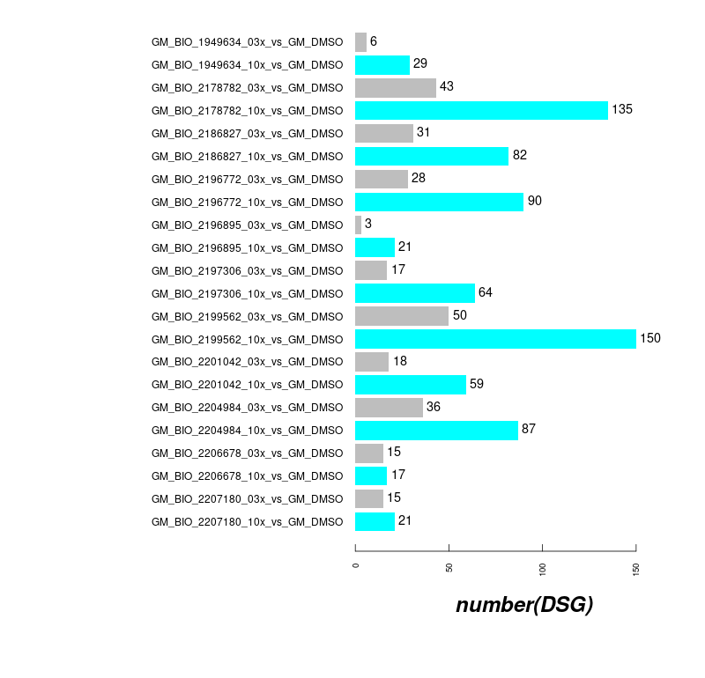
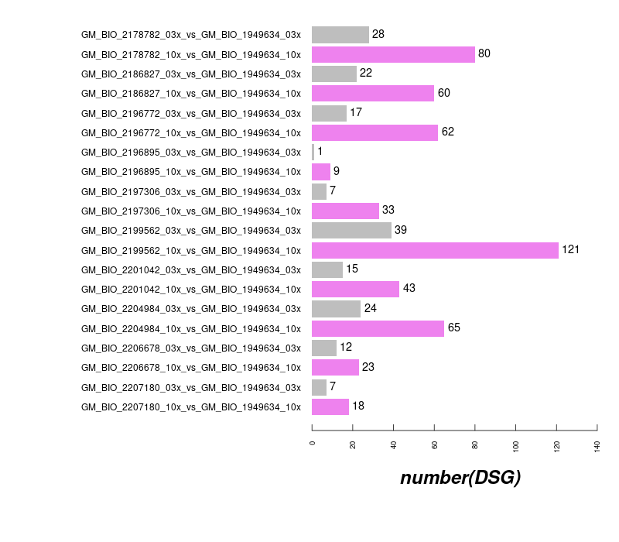
DSG Counts in GM09677c SMA fibroblasts off-Targets (11 compounds + risdplam)

Slide 13
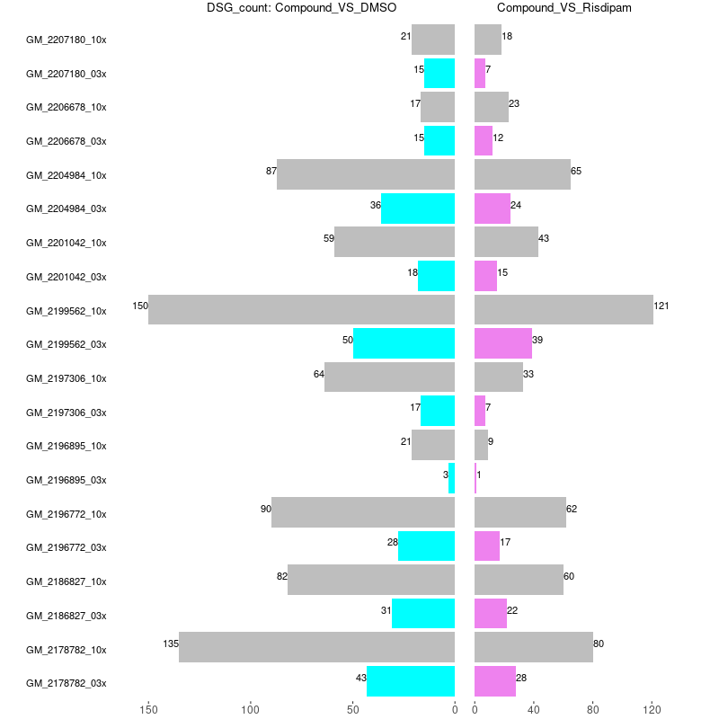
DSG Counts in GM09677c SMA fibroblasts off-Targets (11 compounds + risdplam)

Slide 14
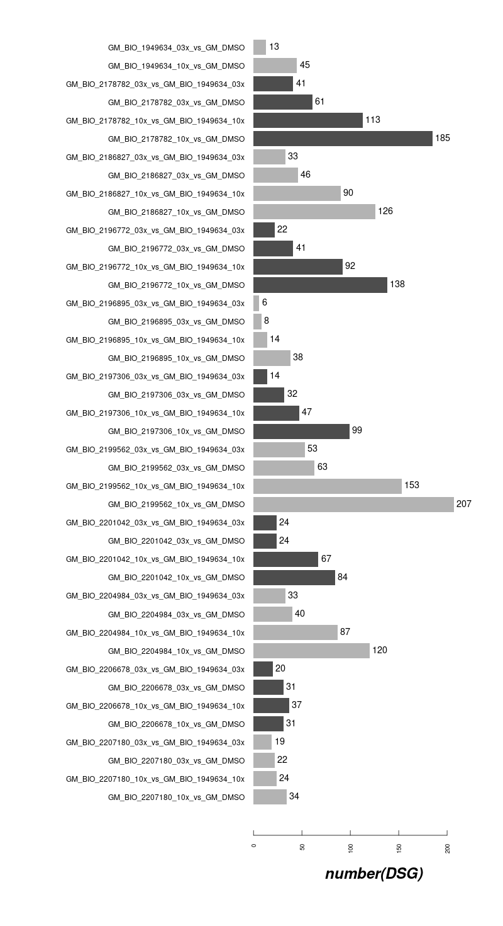
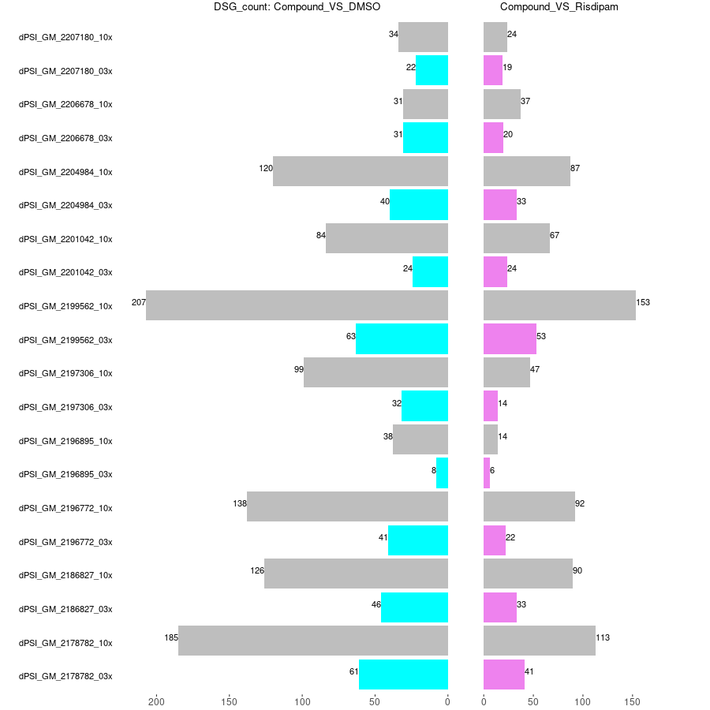
DSG Counts in GM09677c off-Targets (11 compounds + risdiplam)

Slide 15
DSG Counts in GM09677c SMA fibroblasts off-Targets (VS DMSO or risdplam)

Slide 16
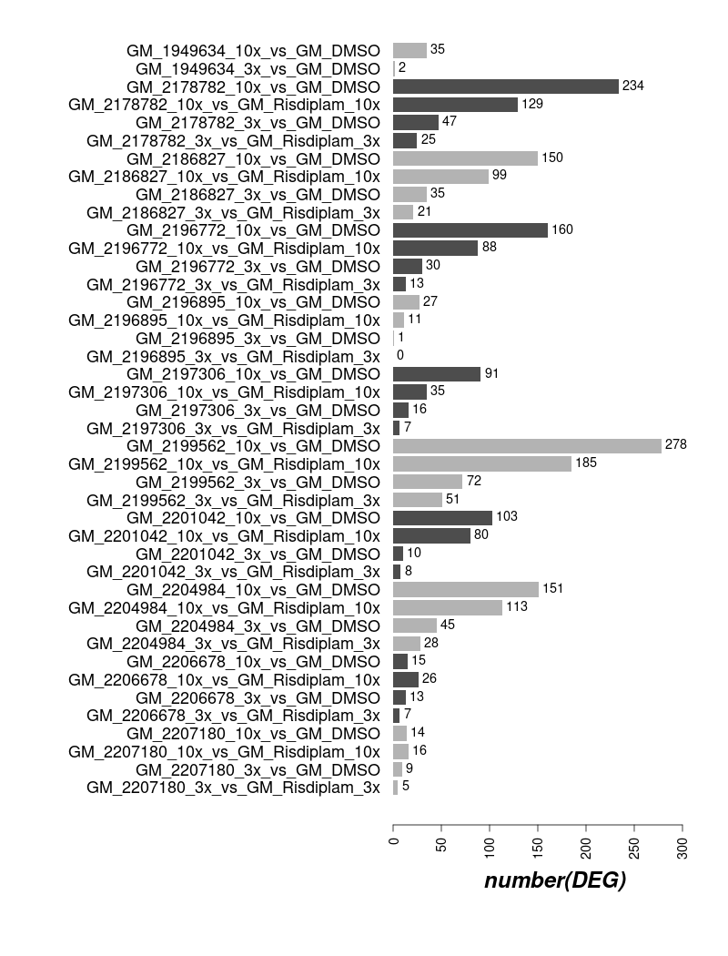
DEG Counts in GM09677c SMA fibroblasts off-Targets (11 compounds + risdplam 1.5 FC Padj 0.05)

Slide 17
DEG Counts in GM09677c SMA fibroblasts off-Targets (VS DMSO or risdplam)

Slide 19
Analysis Goals
On-Target effect: Does the compound change SMN2 exon7 usage? How much?
SMN2 exon7 inclusion
Off-Target DSG: How low can we go?
Number of differentially spliced genes (DSG) for each compound, dose-dept.
Overlap of DSGs among the compounds, especially with Risdiplam.
Motif analysis: What is the enriched sequence across the off-targets?
Confirm the expected GAGTAAG motif.
Differentially expressed genes (DEG): Which genes are affected in expression?
Numbers and overlaps, as in DSG.
(DEG with cryptic exon, not necessarily DSG. ➔ potential safety?)
(Comparison to historical risdiplam data)
(Different cell lines potentially, can try but may be variable)
[Christina Gallo, Modified]
Notes:
Submission amount/concentration?

Slide 27
Differentially Spliced Genes

Slide 28
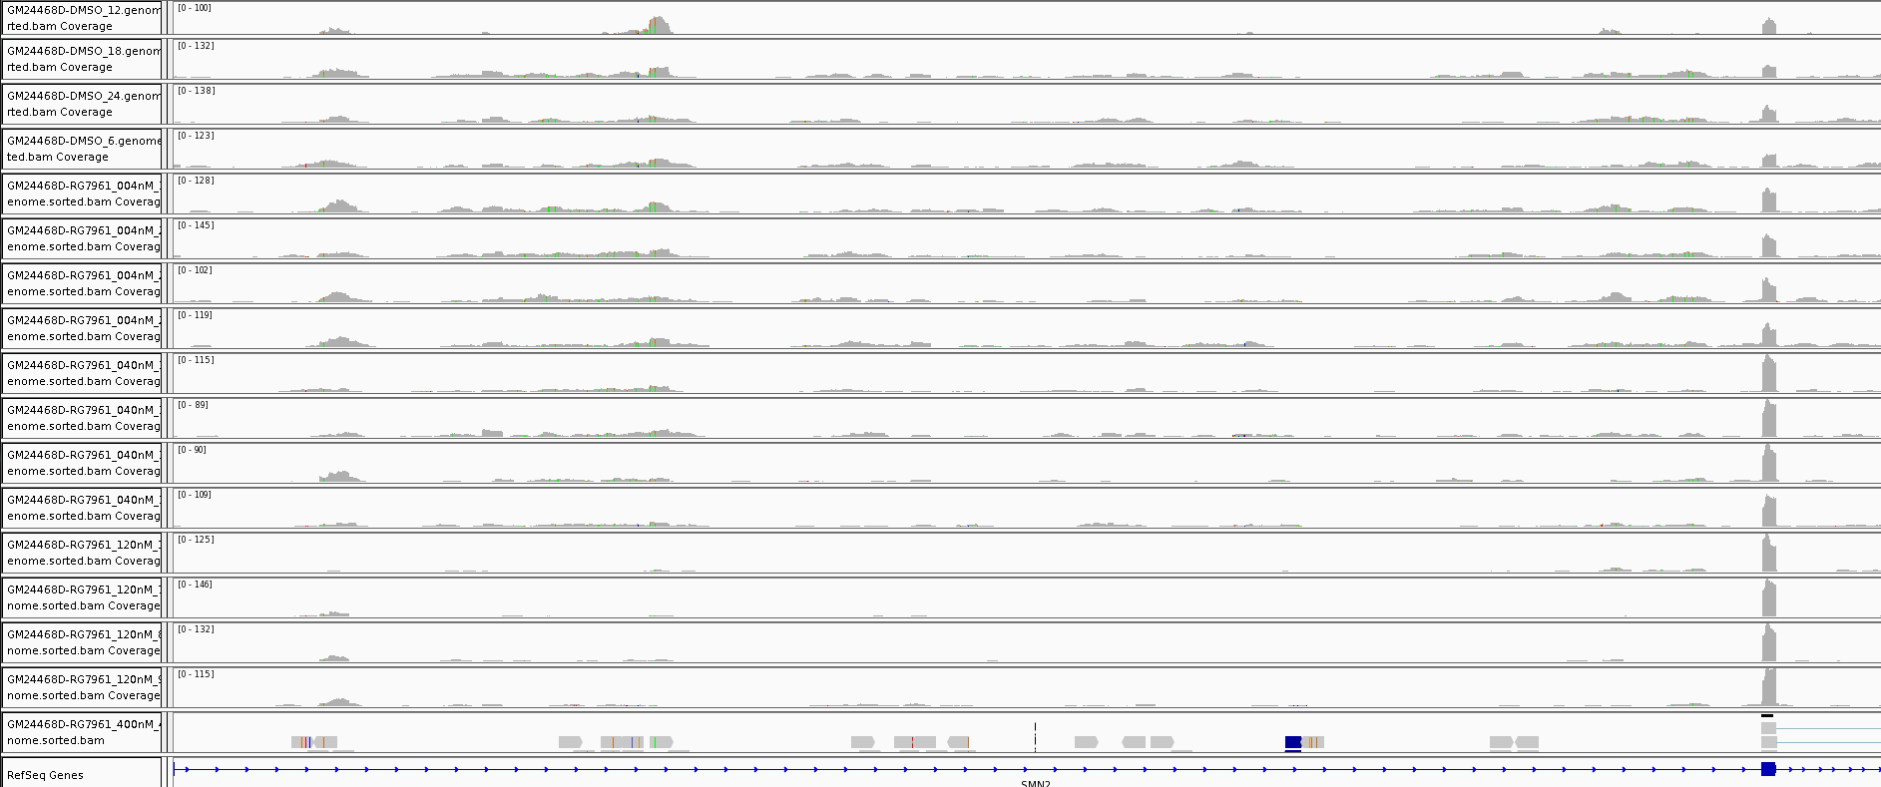
Example: SMN2 exon7 inclusion upon Risdiplam treatment
RNAseq: iPSC-MN, GM24468D
DMSO
DMSO
004nM
004nM
040nM*
040nM*
120nM
120nM
➔ How can we quantify such events for all genes?
*EC50 in iPSC-MN

Slide 29
Percent Spliced In (PSI) is used as a measure of local exon usage
Focus on local splicing event rather than quantification of full splice isoforms
Measure1: Percent Spliced In : e.g., exon skipping: PSI=
C₁+C₃
C₁+2*C₂+C₃
C₁
C₁+C₂
≈
Measure2: dPSI = PSI_{treatment} - PSI_{control}
C₁
C₃
C₂
Example: SMN2 exon7
PSI(Risd)=1.0 (100% inclusion)
PSI(DMSO)=0.4 (40% inclusion)
➔ dPSI=0.6 (60 percent-point difference)

Slide 30
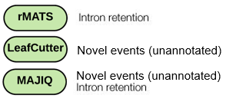
Three different algorithms are used for local splice analysis
Input: read counts from RNA-seq
Each algorithm uses
(1) different definition of PSI
(2) different statistical models
Which algorithm is the best?
If not identified, what do we do?
Output: PSI, dPSI, statistical significance
[with Eric Marshall, Ellen Tsai, Jessica Hurt]

Slide 31
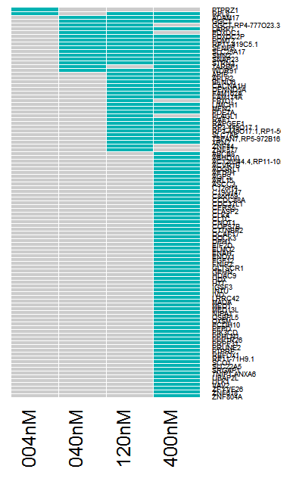
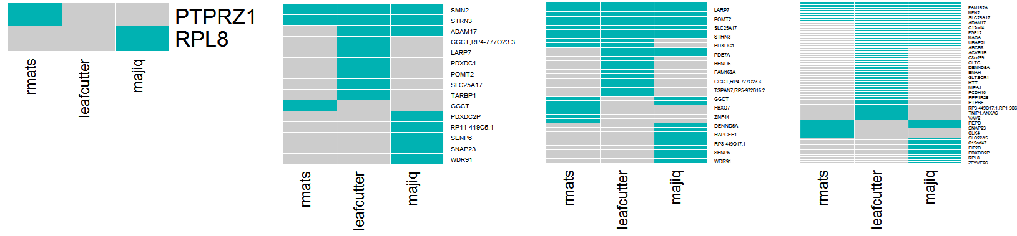
Union of DSGs from three algorithms are used
Genes with at least one event that pass significance and dPSI filter*
(“gene-level summary”)
Risdiplam:
004nM
040nM (EC50)
120nM
400nM
Union per dose
iPSC-MN
(GM24468D)
Pass filter*
Not passed
*|dPSI|>0.3, 0.2 (lc) / p.adj<0.05 / PdPSI>0.9 (mj)
Not all genes overlap across algorithms
There is no clear single result that encompasses the rest
(2.1) some discrepancy can be explained by annotated vs novel exon usage
(3) Actual pile ups of sequencing reads support the detected genes
➔ All the genes passed filter from three algorithms are considered as DSG.
Notes:
rMATS: FDR<0.05, dPSI> 0.30
Leafcutter: FDR<0.05, dPSI > 0.20
Majiq: P(dPSI) > 0.90, E(dPSI)>0.30

Slide 32
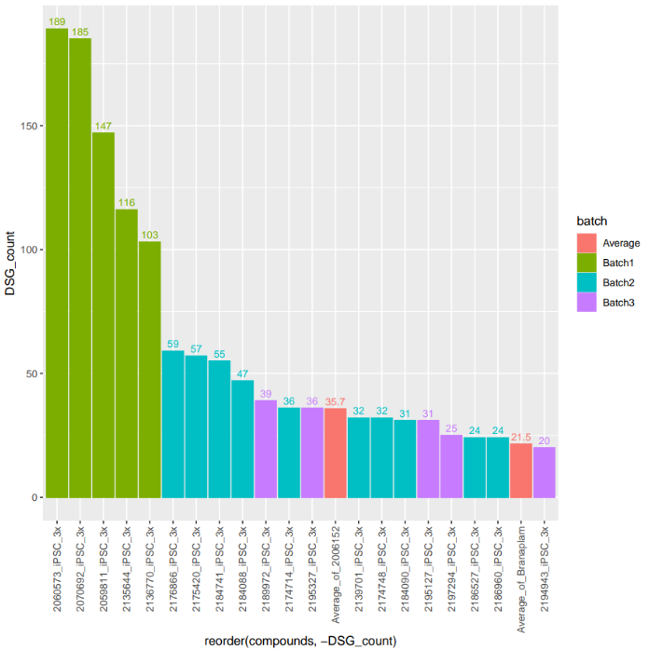
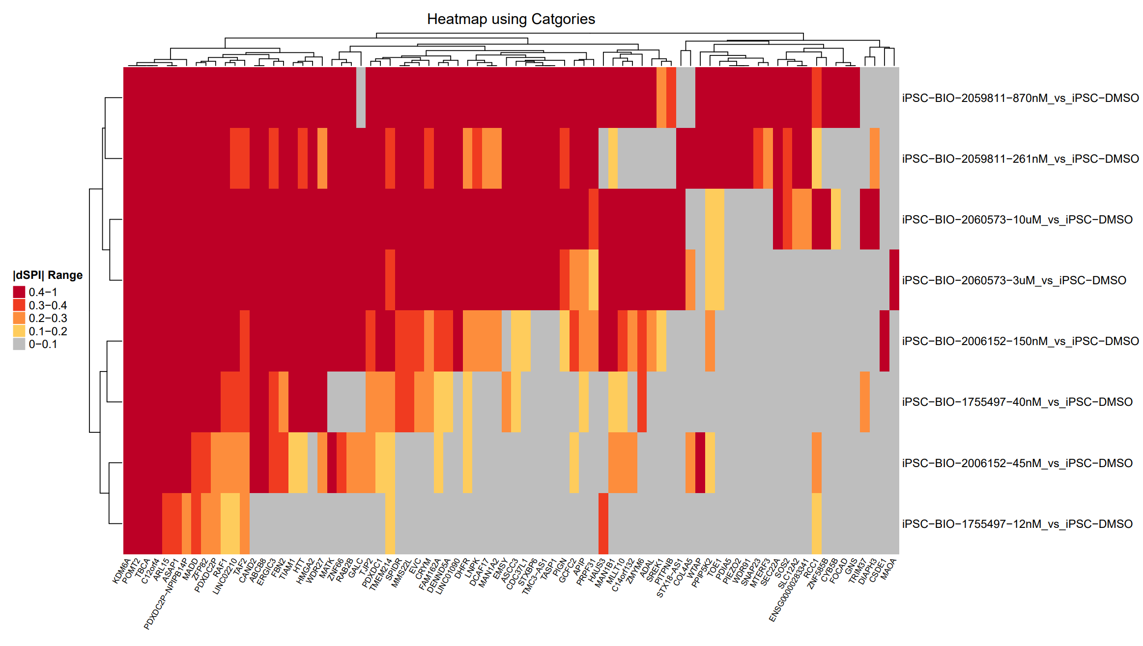
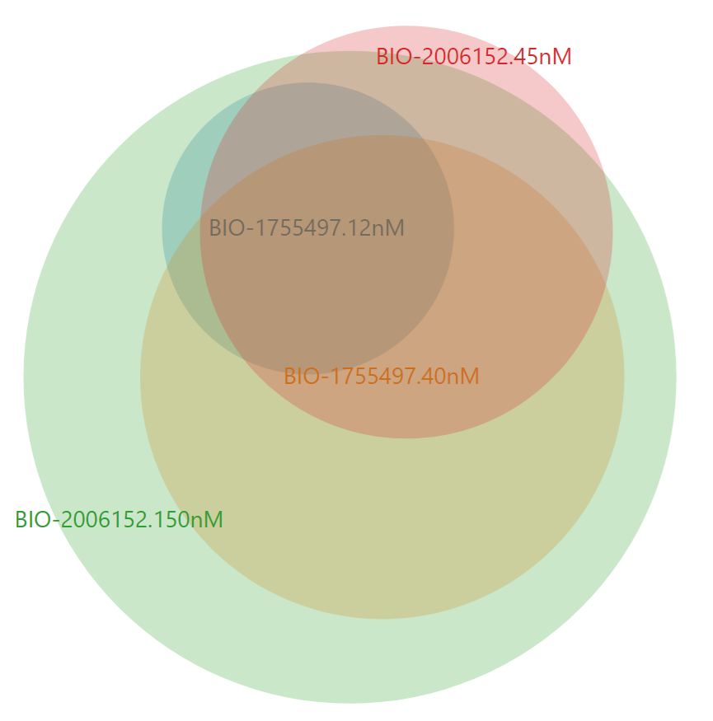
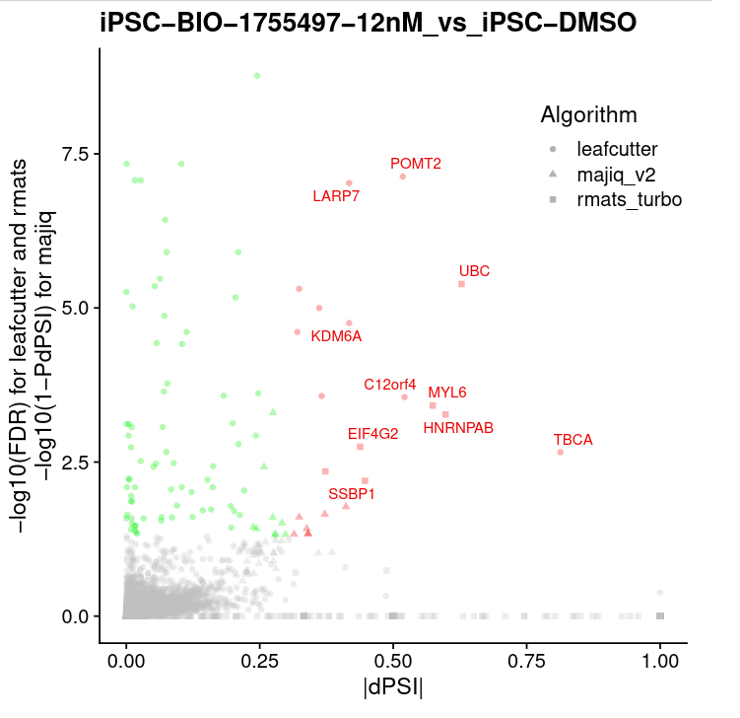

Number of DSG are compared across compounds
Number of DSGs
Overlap of DSGs: Heatmap and Venn diagram
HTT SMSM
color =
round of expr
Compound
DSG count
Gene symbol
Individual genes: Volcano plot
Event level:
Compounds (3x IC50)
Stat.sig
Reduction in DSG are
readily visible
[Zhen Gao, Joon Lee, Magnus Pfaffenbach, Ravi Challa, Eric Marshall, Catherine Guardado]
Max(|dPSI|)
[Yirui Chen, Somya Negi, BioinfoRx]
Notes:
rMATS: FDR<0.05, dPSI> 0.30
Leafcutter: FDR<0.05, dPSI > 0.20
Majiq: P(dPSI) > 0.90, E(dPSI)>0.30

Slide 33
Motif Analysis

Slide 34
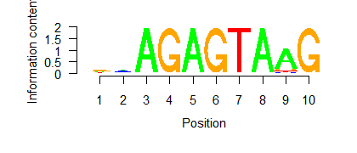
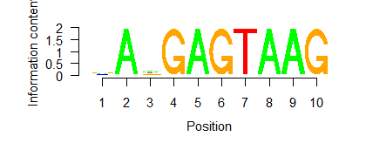
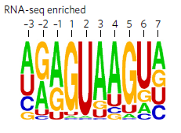
Branaplam and Risdiplam show the expected GAGTAAG motif enrichment
APLP2(+) : GATGA|GTAAG
GGCT(-) : GATGA|GTAGG
POMT2(-) : AAAGA|GTAAG
…
Collect all the 5’ splice-site of DSGs
Collect random 5’ splice-sites
Test whether (1) has different sequence enrichment compared to (2) (Homer)
SMA fibroblast, 10x EC50
[Palacino 2015]: normal fibroblast
-5-4-3-2-1 1 2 3 4 5
-5-4-3-2-1 1 2 3 4 5
Branaplam
Risdiplam
Branaplam (NVS-SM1), 100nM
Confirmatory results.
All of the compounds tested so far do not deviate much from this motif.

Slide 35
Differentially Expressed Genes

Slide 36
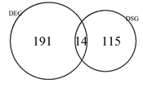
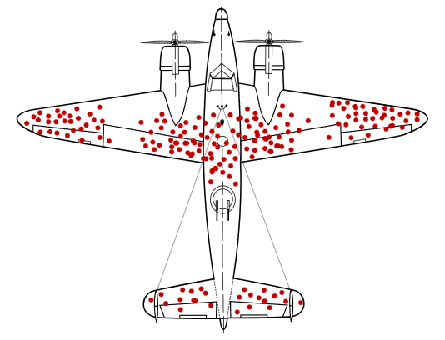
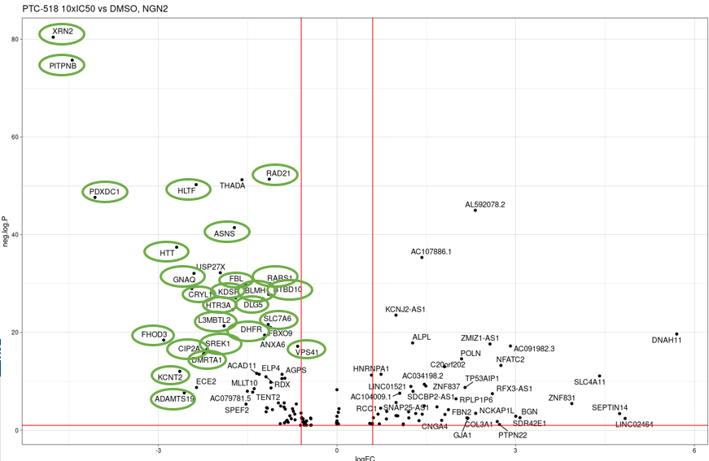
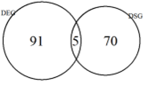
DEG and DSG often have slight overlaps, but NMD might have biased the observation
Collect DEGs
Identify cryptic exon events with NGA motif in (1)
(No need to be DSG per se)
SMA fibroblast, 10x EC50
PTC518, 10xIC50, NGN2
Branaplam
-log(P)
Risdiplam
Log(fold-change) (DEG)
➔ Poison exons were found in the majority of the downregulated DEGs.
➔ Toxicity study
[Joon Lee, modified]

Slide 37
SMN2 RNAseq study
Goal: Perform RNAseq on key compound hits to identify on and off-target activity.
Compare to competitor Risdiplam.
12 Compounds:
BIO-2196772
BIO-1949634
BIO-2207180
BIO-2178782
BIO-2196895
BIO-2197306
BIO-2206678
BIO-2201042
BIO-2204984
BIO-2199562
BIO-2186827
Risdiplam
Controls:
DMSO
Cell model:
GM09677c [SMA fibroblasts]
SHSY5Y [common to HTT program]
Doses
3X_IC50
10X_IC50
Samples: 4 replicates per sample, 2 doses per each of 12 compounds, 4 DMSO x 2 cell lines
**IC50 determined in GM09677c [qPCR screening]
Total # Samples: 184
[Christina Gallo]

Slide 38
Analysis Goals
On-Target effect: Does the compound change SMN2 exon7 usage? How much?
SMN2 exon7 inclusion
Off-Target DSG: How low can we go?
Number of differentially spliced genes (DSG) for each compound, dose-dept.
Overlap of DSGs among the compounds, especially with Risdiplam.
Motif analysis: What is the enriched sequence across the off-targets?
Confirm the expected GAGTAAG motif.
Differentially expressed genes (DEG): Which genes are affected in expression?
Numbers and overlaps, as in DSG.
(DEG with cryptic exon, not necessarily DSG. ➔ potential safety?)
(Comparison to historical risdiplam data)
(Different cell lines potentially, can try but may be variable)
[Christina Gallo, Modified]
Notes:
Submission amount/concentration?

Slide 39
Supplementary slides

Slide 40
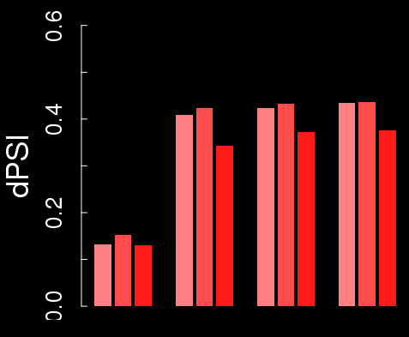
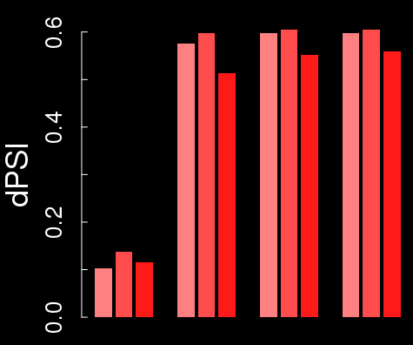
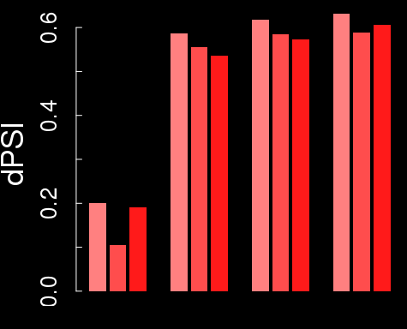
Example: Delta-PSI of SMN2 exon7 is around 60% in iPSC-MN
rMATS
Leafcutter
Majiq
GM24468D
HNDS006-01C2
HNDS0030-01
FDR
0.02
0.33
0.001
FDR
0.59
0.37
0.59
004 040 120 400nM
004 040 120 400nM
004 040 120 400nM
dPSI ~ 60%, which is higher than ~50% seen in fibroblast.
➔ (1) baseline PSI in untreated SMA iPSC-MN is ~40%, different from fibroblast.
(2) Risdiplam bring PSI close to 100%, as in fibroblast.
Notes:
Junc_coords: hg19, chr5:69366578-69372846

Slide 41
The difference in SMN2 dPSI between algorithms comes from varying definitions of “PSI”
rMATS : does not even use the word PSI, just called “Inclusion Level Difference”
Leafcutter: “Percent Spliced In”
Majiq: “Percent Selected Index” (one junction at a time)
<DMSO>
<RG7916>
C₁=16
C₃=29
C₁=54
C₃=79
Example:
Delta
C₂=20
C₂=0
rMATS
C₁+C₃
C₁+2*C₂+C₃
0.53
1.0
0.47
Leafcutter
C₁+C₃
C₁+C₂+C₃
0.69
1.0
0.31
Majiq
C₁ C₃
C₁+C₂ C₂+C₃
or
0.44 or 0.59
1 or 1
0.56 or 0.41

Slide 42
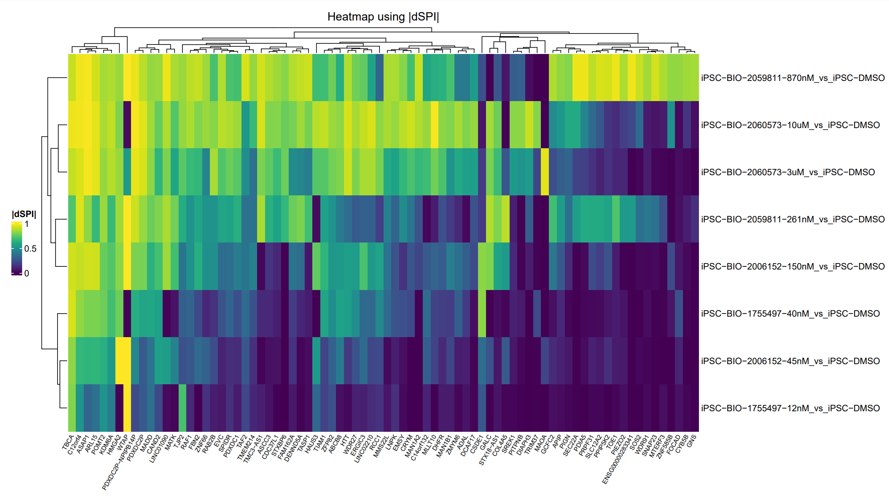
Heatmap by |dPSI| Values (Optional Plot)

Slide 43
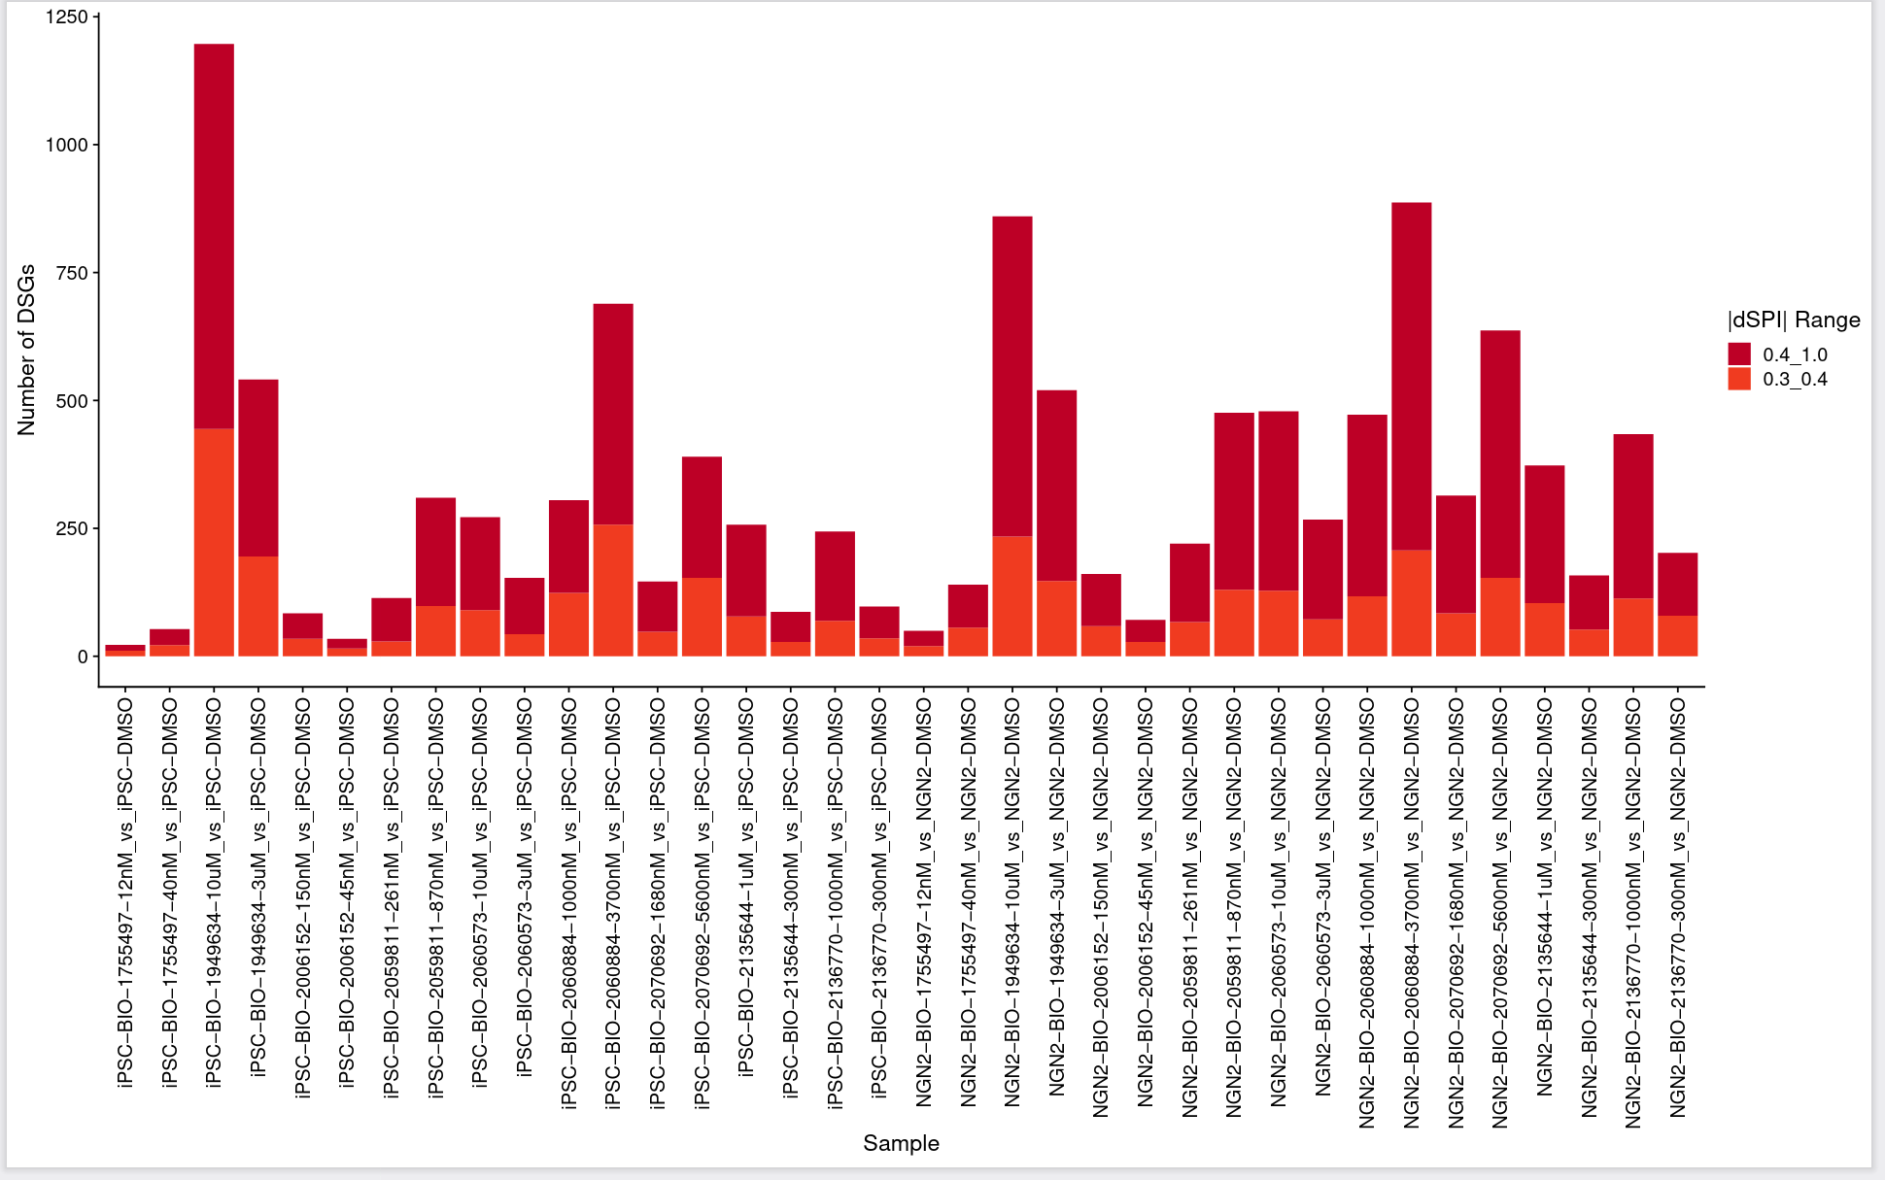
Barchart of Number of Differentially Spliced Genes
Default plot.
DSGs with |dPSI|>0.3 are shown.
Only significant genes are shown (FDR<0.05, or PdPSI>0.95 for majiq).

Slide 44
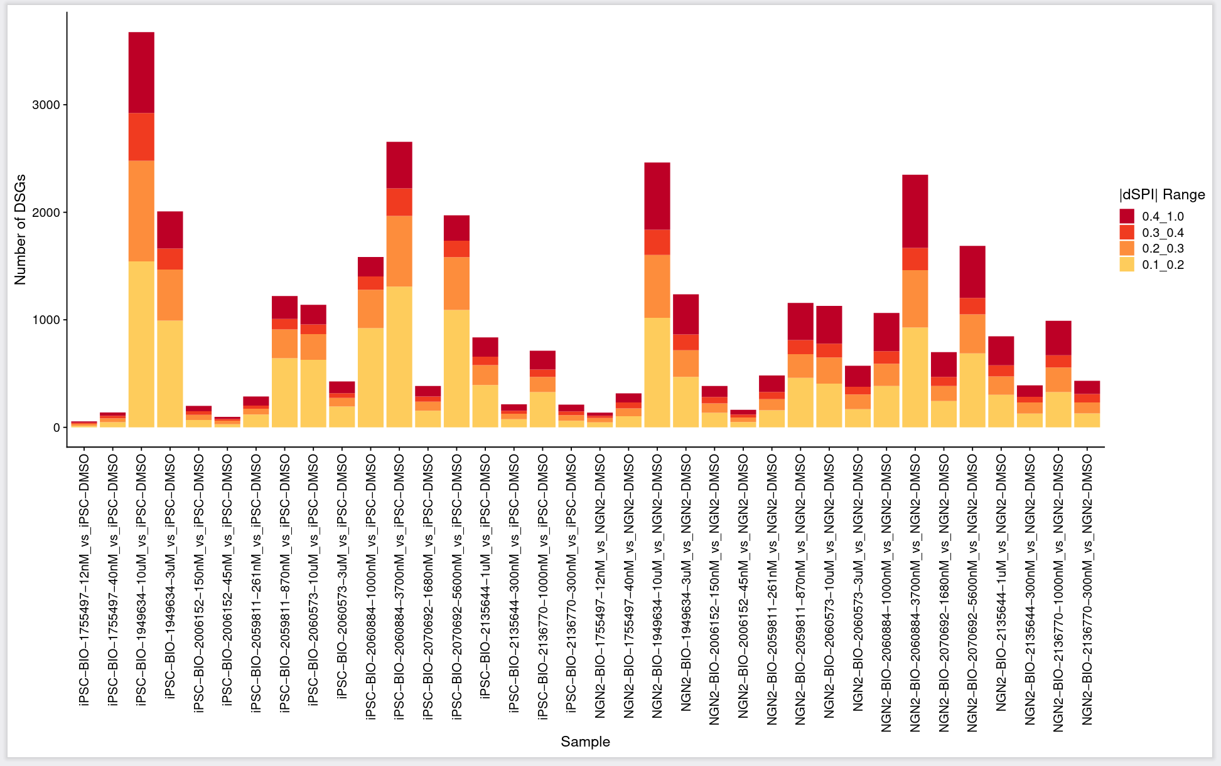
Barchart of Number of Differentially Spliced Genes
(Optional Plot)
DSGs with |dPSI|>0.1 are shown.
Only significant genes are shown (FDR<0.05, or PdPSI>0.95 for majiq).

Slide 45
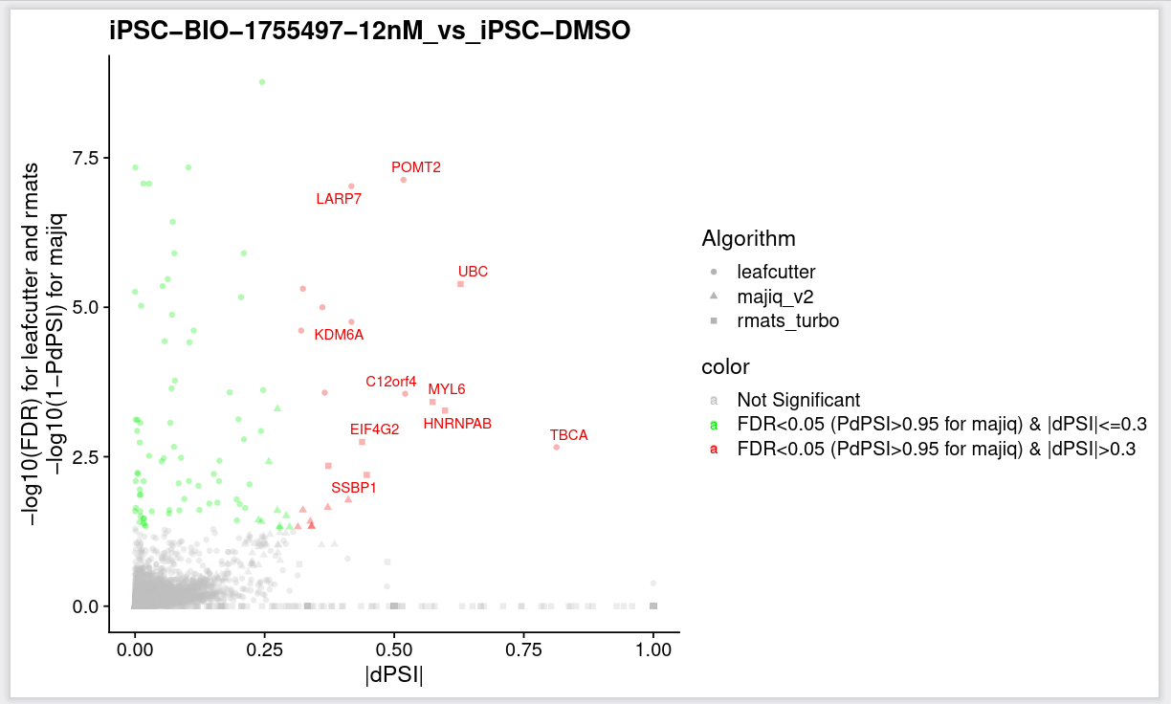
Volcano Plot
Top 10 DSGs are highlighted in red.

Slide 46
Heatmap by |dPSI| -Optional Five Categories
Only significant genes are selected and colored (FDR<0.05, or PdPSI>0.95 for majiq).

Slide 47
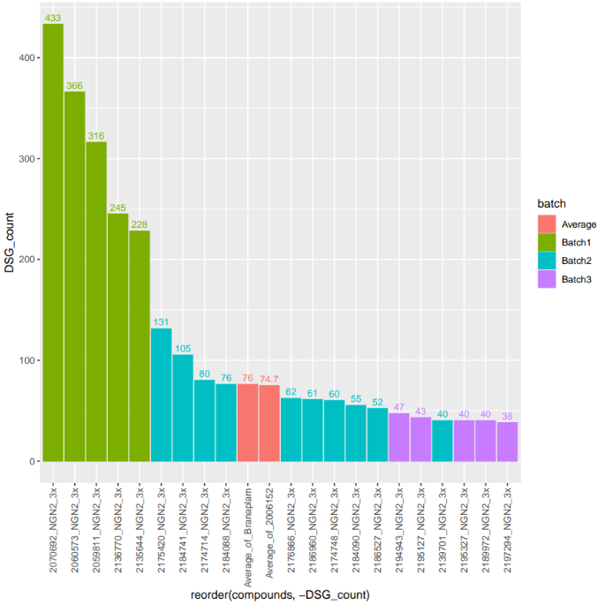
Zhen – Magnus is expecting a DEG table like this

Slide 48
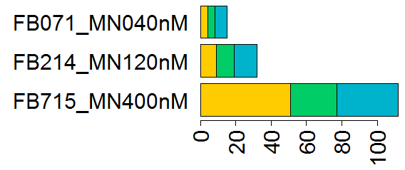
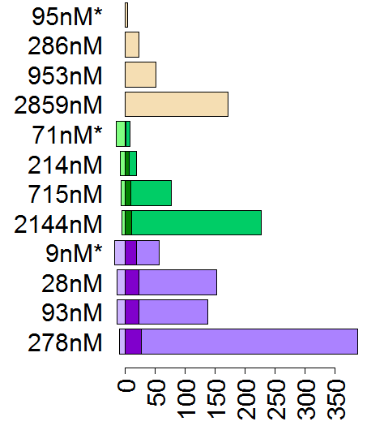
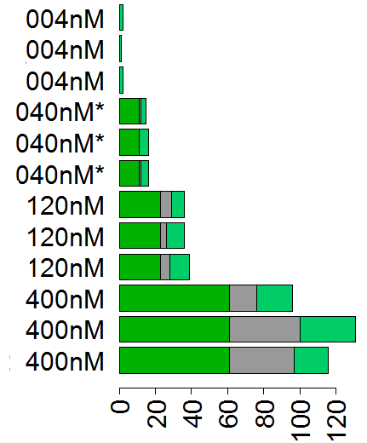
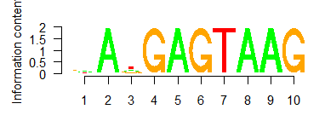
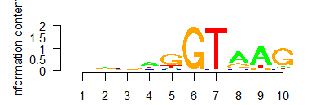
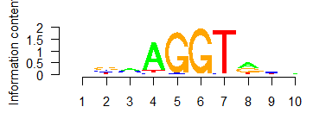
Off-target splicing statistics for three compounds tested in SMA fibroblast and iPSC-MN
Fibroblast: more splice off-targets
are detected than reported
iPSC-MN: ~40% off-targets
are cell-line specific
Fibroblast ≠ iPSC-MN:
~25% of DSG are shared
Current expr only
1
Unique to cell line
BIO
1790727
In both
2
Cell lines
In 2 cell lines
Publication^{[1]} only
|dPSI|>0.3
3
In all 3
Fibroblast only
…
Number of DSG
Shared
iPSC-MN only
Risdiplam
Off-targets can have
mismatched motifs
Branaplam
Most enriched
3-mismatch
Number of DSG
Number of DSG
Risdiplam has fewer off-targets
than Branaplam
Number of off-targets is
similar to fibroblast
5-mismatch
[1] Sivaramakhrisian, 2017
(*EC50)

Slide 49
Acknowledgement
GTB
Christina Gallo
Joon Lee
Jessica Hurt
TCS
Sebastien Rauch
Paige Cundiff
NGS
Ravi Challa
Thomas Carlile
Mei Liu
Chao Sun
NDRU
Catherine Guardado
Med Chem
Magnus Pfaffenbach
James Harvey
Chem Biol Proteomics
Mercedes Beyna
Susanne Swalley
TDS
Zhen Gao
Yirui Chen
Somya Negi
DLI
Eric Marshall
BioInfoRx
Xinmin Zhang
Derrick Cheng

Slide 50
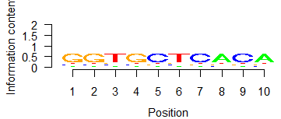
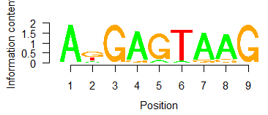
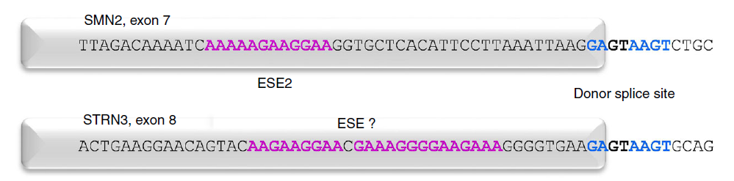




Near 5’SS, AnGA|GTAAG is found as enriched motif
iPSC-MN + Risdiplam, “Spliced Exon” from rMATS only, ±5bp from the end of the exon
Homer, background matched by ±5bp from random exons
HNDS0006_01, dPSI>0.3
HNDS0006_01, dPSI>0.1
comparison: Sivaramakrishnan, 2017
40nM
120nM
(“AAAAAGAAAGAAA” was not detected in the internal dataset)
400nM
(The other cell lines showed very similar results)
(±100bp also showed very similar result)
Notes:
C:\Users\dhuh\Desktop\Project\SMA\TST11451_SMASM_iPSCMN\analysis_motif

Slide 51











A-1G becomes an off-target only when canonical TAAG is not in place
SMN-C5
Probably GGTnnn became a weak binding site as it lost AAG to nnn, and splicing on this weak site can be enhanced by risdiplam. If the sequence were GGTAAG, it would have been spliced well to begin with, just like Campagne paper. (Sue Swalley)
-5-4-3-2-1 1 2 3 4 5
6
5
4
num. mismatch
From AnGAGTAAG
3
2
1
0
Risdiplam
-5-4-3-2-1 1 2 3 4 5
➔ splicing of off-targets with mismatches might have different structure with compound-bound form
Campagne 2019

Slide 52




Genes with mismatches often have high PSI in DMSO
iPSC-MN from HNDS0030-01 cell line
(1x EC50)
(10x EC50)
(risdiplam)
dPSI=0.3
dPSI=-0.3
Num.mismatch
(DMSO)
Many of genes with < 2 mismatches (blue and teal ) have PSI_ref<0.5
(1.1) Genes with <2 mismatches often have dPSI>0.3 (as in slide 18)
Most of the genes with >3 mismatches (orange~red) have PSI_ref > 0.8, hence only have ~0.2 dPSI room to change.
(2.1) This is consistent with “G|GT” – the ‘canonical’ site - that appears for genes with > 3 mismatches.
(2.2) At 10x EC50, some of genes with >3 matches also have low PSI_ref, and low PSI_alt.

Slide 53




Off-targets can have mismatched motifs, across all doses of risdiplam in iPSC-MN
-5-4-3-2-1 1 2 3 4 5
Position
1~2 : always GT
-1 : A→G, canonical 5’ss?
3~5 : AAG fades
-3: A→N from 1 mismatch on.
6
5
4
num. mismatch
From AnGAGTAAG
3
2
1
0
-5-4-3-2-1 1 2 3 4 5
HTT: CAGAGTAAGGGGG
speculation:
1. 0.1 vs 0.3: Low dPSI threshold allows more fraction of mismatched motifs
=> mismatched motifs have lower probability of getting spliced.
2. Across dose: Fraction of num.mismatch do not change much as a fnc
of increasing dose => off-target motifs are expected to have similar EC50
>
dPSI
dPSI
dose
dose

Slide 54

















BIO90702, Branaplam, and Risdiplam share GAG|TAAG motif
-5-4-3-2-1 1 2 3 4 5
-5-4-3-2-1 1 2 3 4 5
90702: nnGAGTAnG
LMI070: nAGAGTAnG
RG7916: AnGAGTAAG
1. Similar progression across all three compounds:
1~2: GT
-1: A->G
3~5: AAG fades
2. Differences:
-2: 90727 and LMI070 have
stronger G-> A
-3: A in LMI070
-4: A in RG7916
-5-4-3-2-1 1 2 3 4 5
6
5
4
num. mismatch
From motif/compound
3
2
1
0
-5-4-3-2-1 1 2 3 4 5
-5-4-3-2-1 1 2 3 4 5
-5-4-3-2-1 1 2 3 4 5
-5-4-3-2-1 1 2 3 4 5
90727
LMI070
RG7916
RG7916, iPSC-MN
Notes:
Alldose, per compound

Slide 55



Compound Alias
Current experiment
BIO-1790727
Sivaramakrishnan
LMI070, Branaplam, NVS-SM1, BIO-1755497
“Compound 10”
SMN-C3
Ratni
RG7916, Risdiplam,
BIO-1949634
“Compound 2”
RG7800
Notes:
BIO-1790727 is what the BioAssays and HTS group use as a positive control (lower tox than LMI070)
LMI070, BIO-1755497, Branaplam, NVS-SM1
SMN-C2 is BIO-1932671
RG7916, Risdiplam, free base version of the compound is BIO-1949634
RG7916 more soluble HCl salt is BIO-1949634
SMN-C3 – I do not know. (However, we have an analog (missing a methyl group) of SMN-C3 called BIO-1932673.)
Siva would be able to give you the BIO #s that I don’t have.

